Slide 1
Mollier chart: Enthalpy – Entropy(h-s) diagram for water and steam
It is a graphical representation of the steam tables, in which enthalpy is plotted along the ordinate and entropy along abscissa.
The liquid line and dry saturated lines meet at C, which is the critical point.
The critical point corresponds to the enthalpy of liquid and dry saturated steam at 221.2 bar.
The x-axis represents the entropy of 1kg of water and steam above the freezing point of water.
The y-axis shows the values of specific enthalpy (total heat).

Slide 2
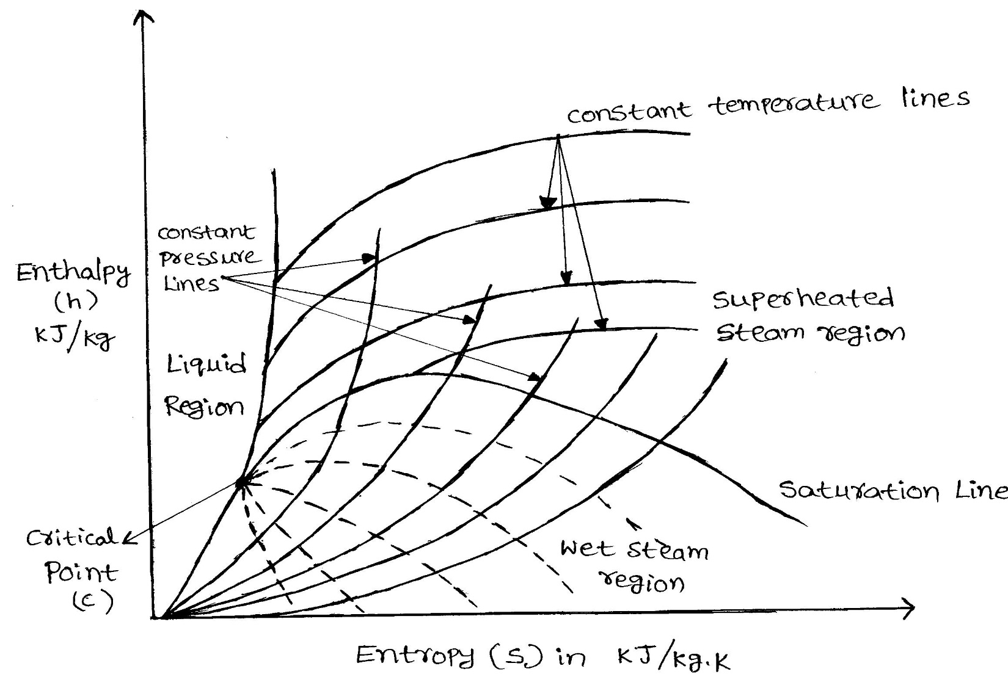
Mollier chart: Enthalpy – Entropy(h-s) diagram for water and steam
Enthalpy-entropy (h-s) plot for water and steam

Slide 3
Mollier chart: Enthalpy – Entropy(h-s) diagram for water and steam
The h-s diagram is divided into two portions by a line termed saturation line.
In the lower (wet) region, the temperature of steam remains constant at a given pressure and in the upper (superheated) region, the temperature of steam increases at the given pressure.

Slide 4
Mollier chart: Enthalpy – Entropy(h-s) diagram for water and steam
The Mollier diagram has the following lines:
Dryness fraction lines
Constant volume lines
Constant pressure lines
Isothermal lines
Isentropic lines
Throttling lines

Slide 5
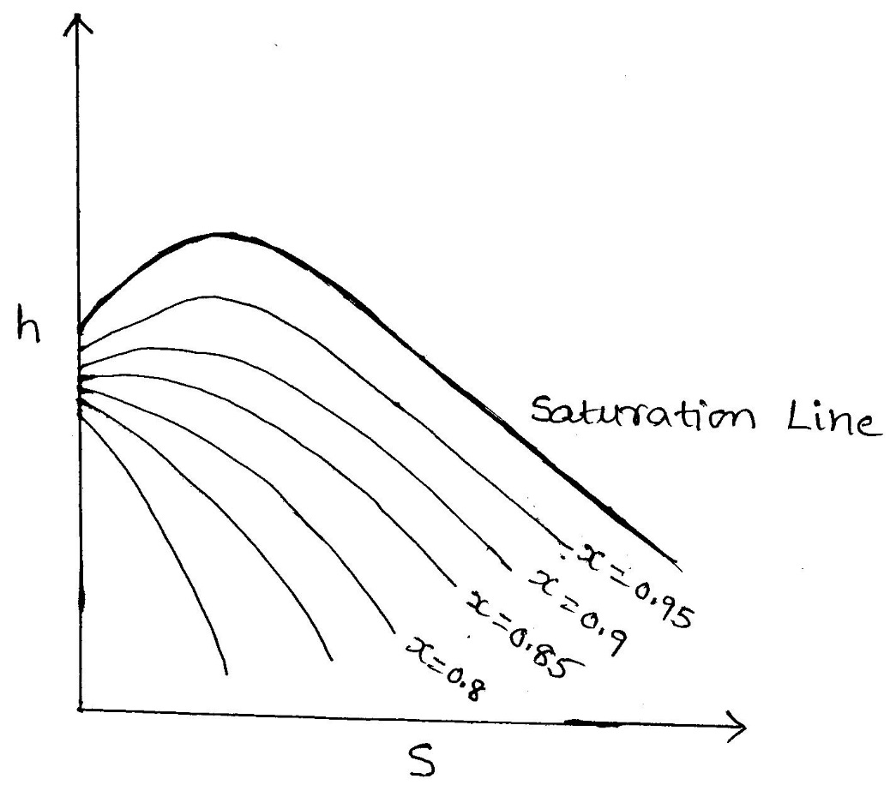
Dryness fraction lines
Dryness fraction lines are drawn only below the saturation line, represents the condition of wet steam between various values of enthalpy and entropy.

Slide 6
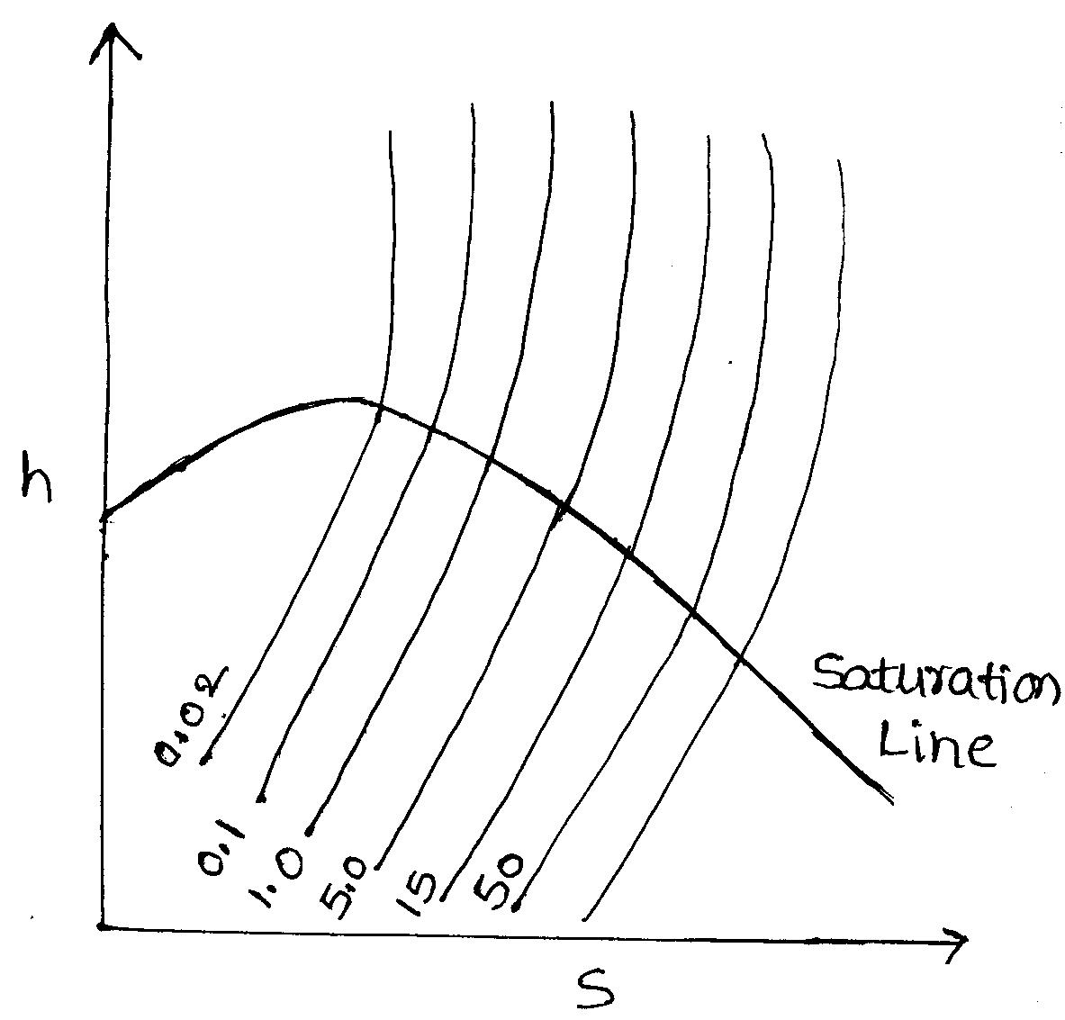
Constant volume lines
Constant volume lines are drawn in both wet steam and superheated steam region.
These lines are straight in wet region but curved up ward above the saturation curve.

Slide 7
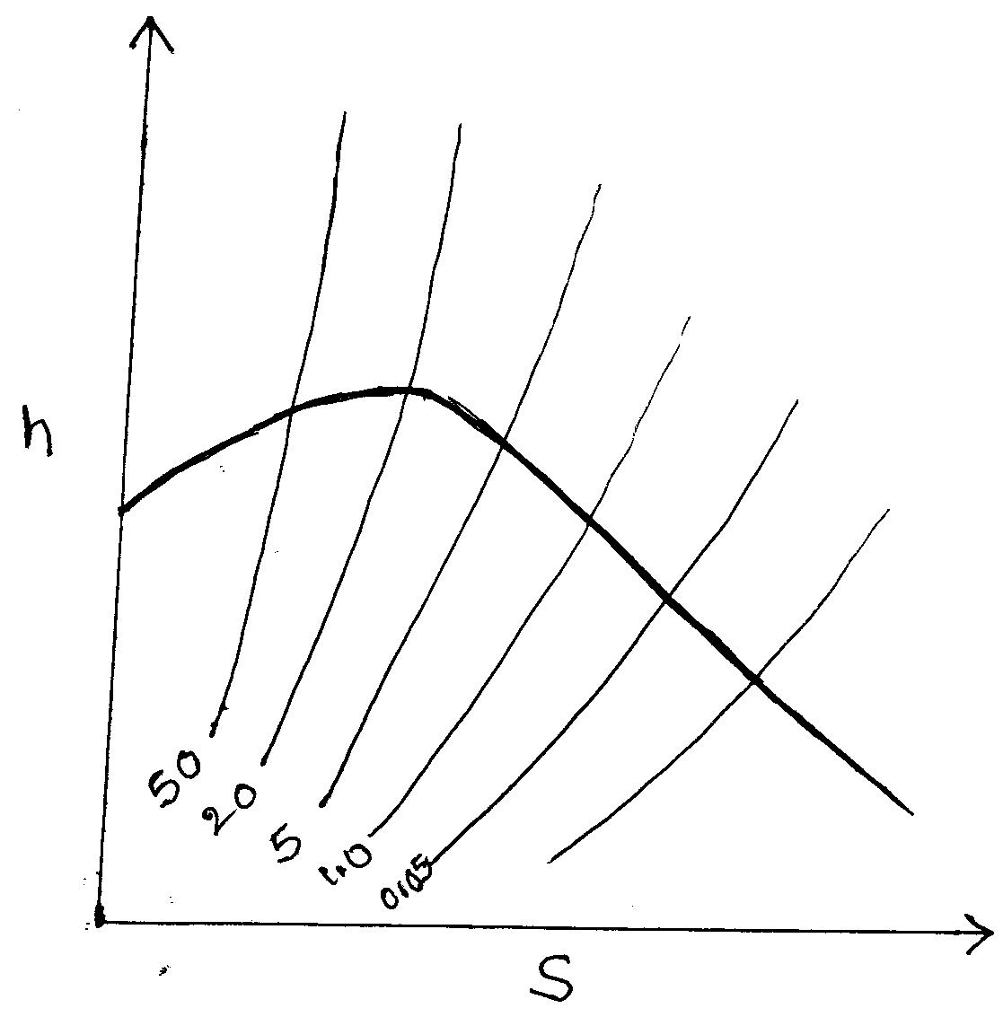
Constant pressure lines
Constant pressure lines are drawn in both the wet steam region and superheated steam region.
These lines are straight in the wet steam region.

Slide 8
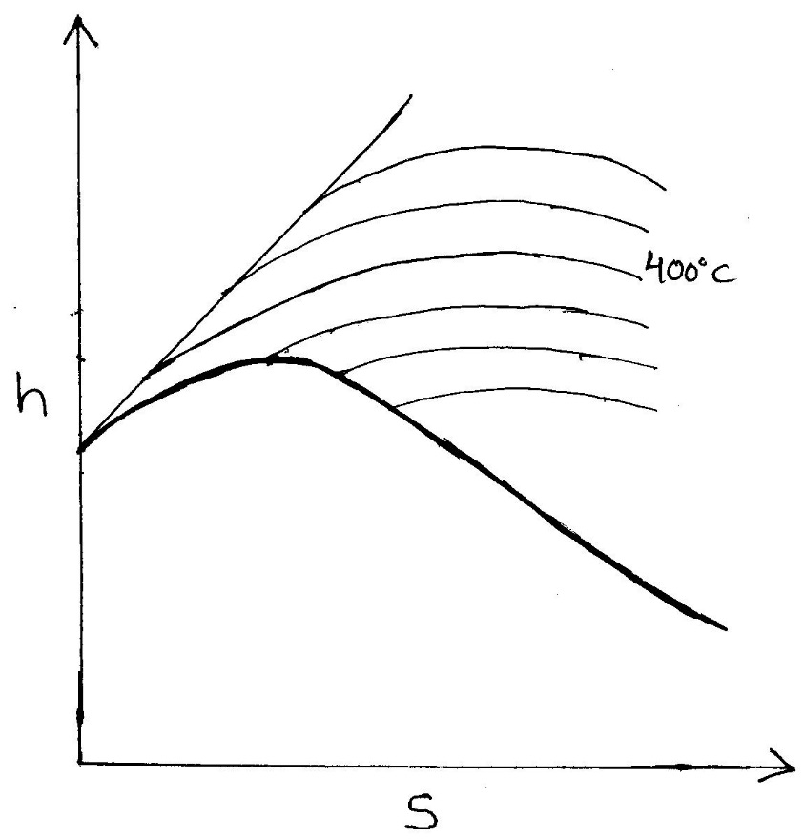
Isothermal lines
These lines are drawn only above the saturation line.
These lines represents the condition of superheated steam between various values of enthalpy and entropy

Slide 9
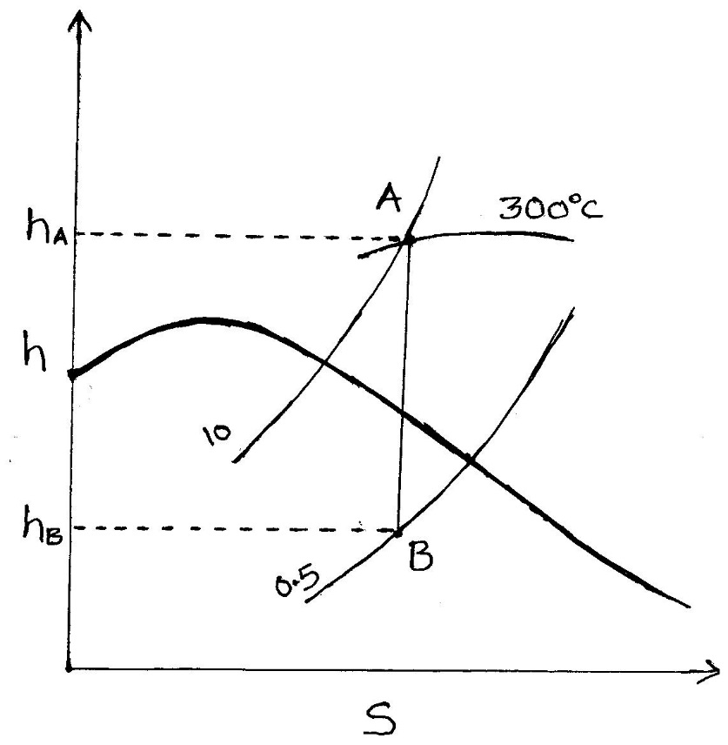
Isentropic lines
Isentropic process is marked by a vertical line.
Increase in enthalpy from B to A = h_{A} - h_{B}

Slide 10
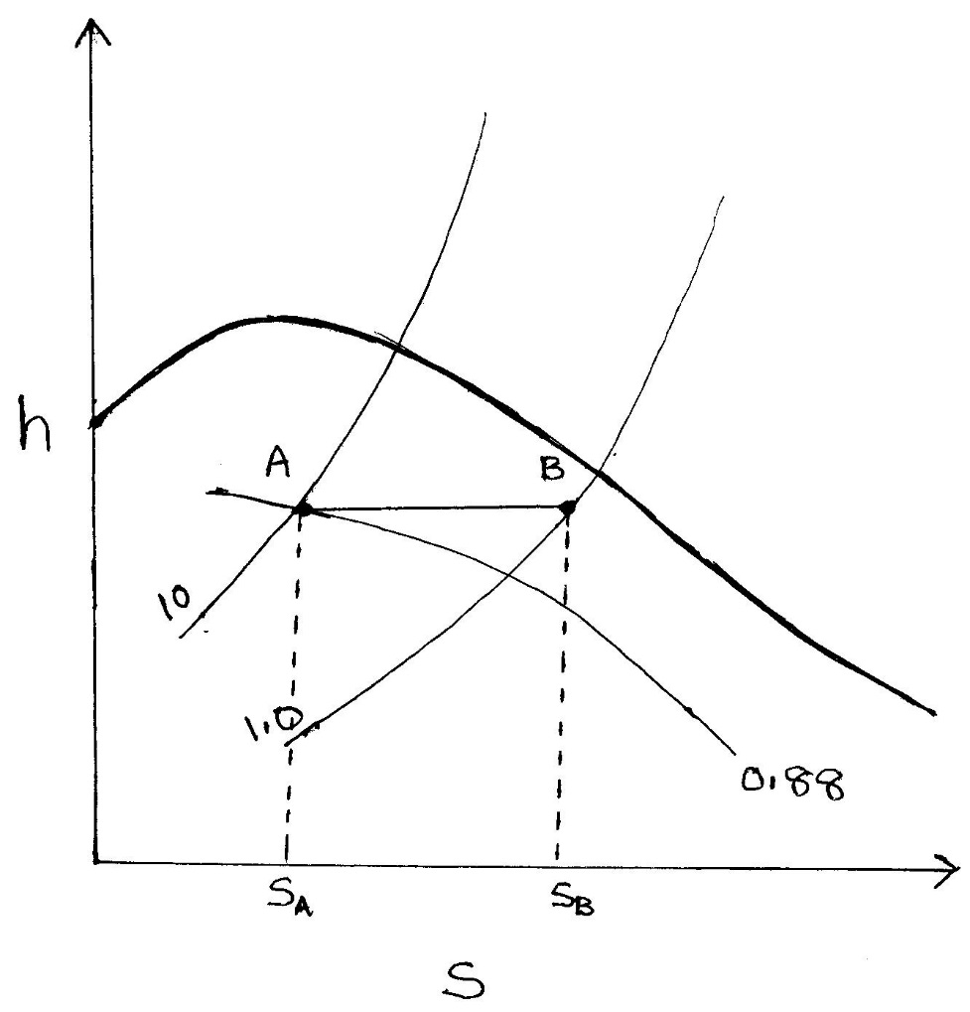
Throttling line
During throttling process, there is no change in enthalpy.
Throttling process is marked by a horizontal line AB
Increase in entropy from A to B = s_{A} - s_{B}

Slide 12
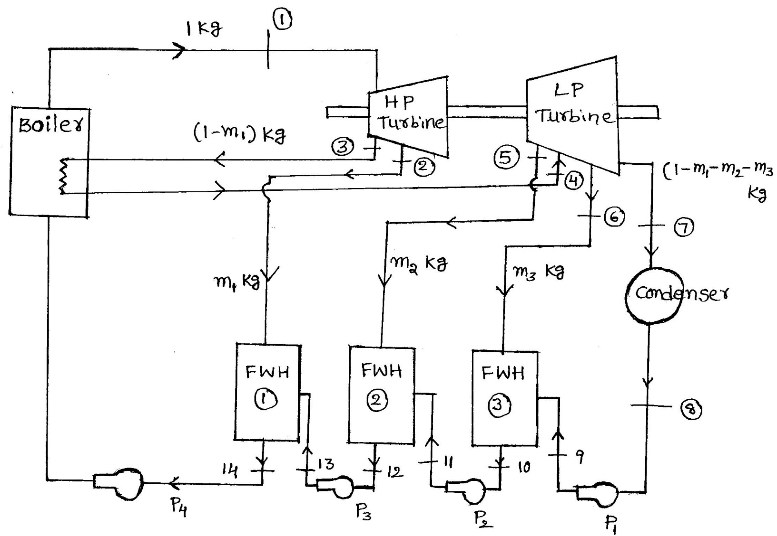
Reheat-regenerative cycle
Flow diagram of a reheat-regenerative cycle: with reheat and three stages of feed water heating

Slide 13
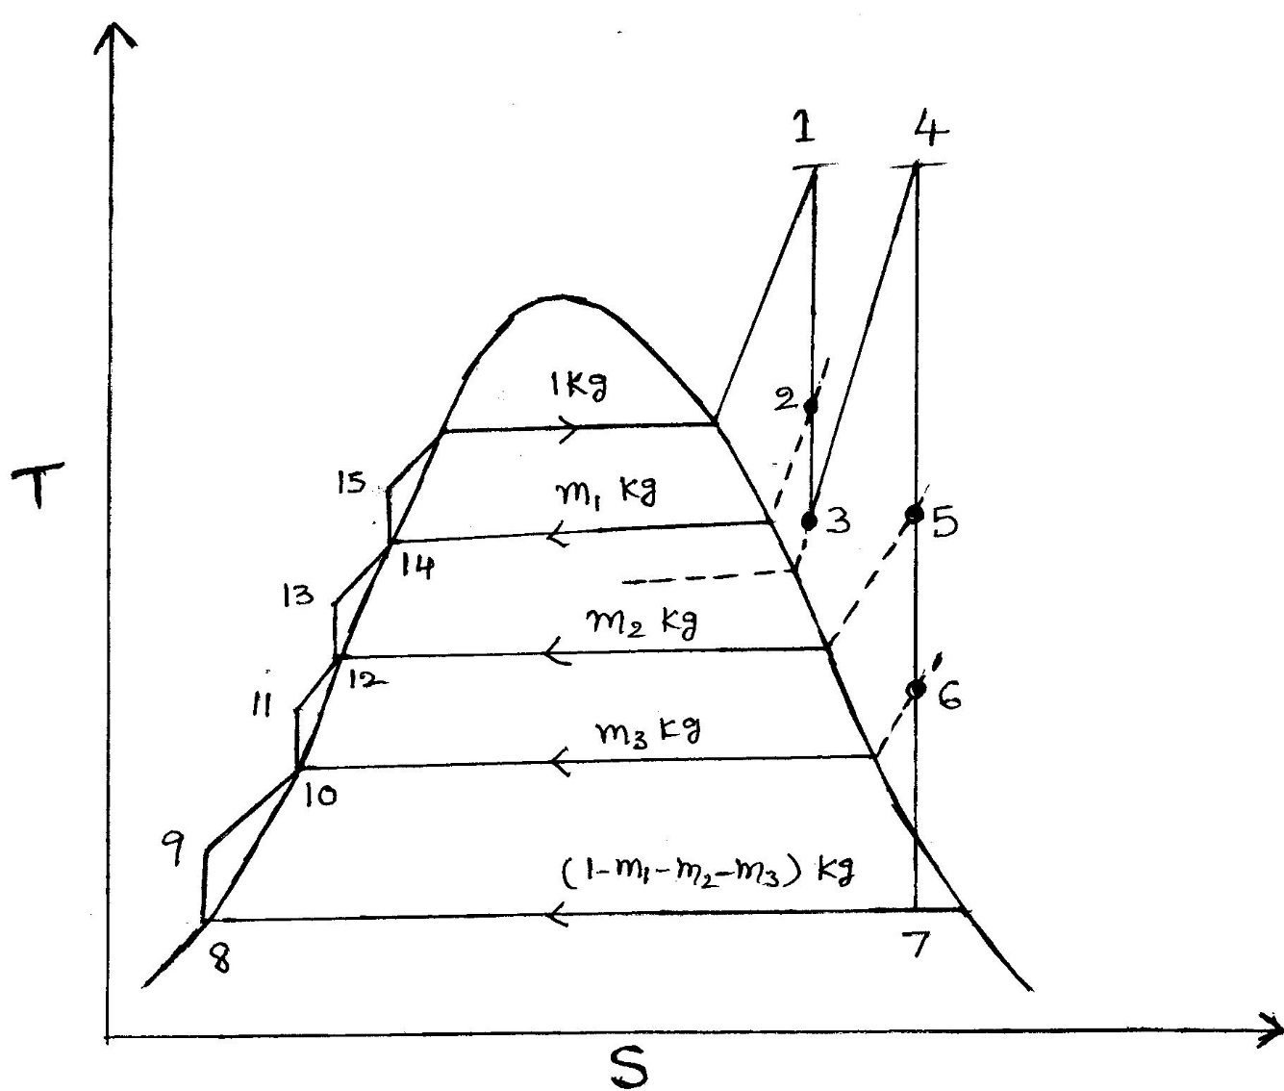
Reheat-regenerative cycle
T-s plot for reheat-regenerative cycle: with reheat and three stages of feed water heating

Slide 14
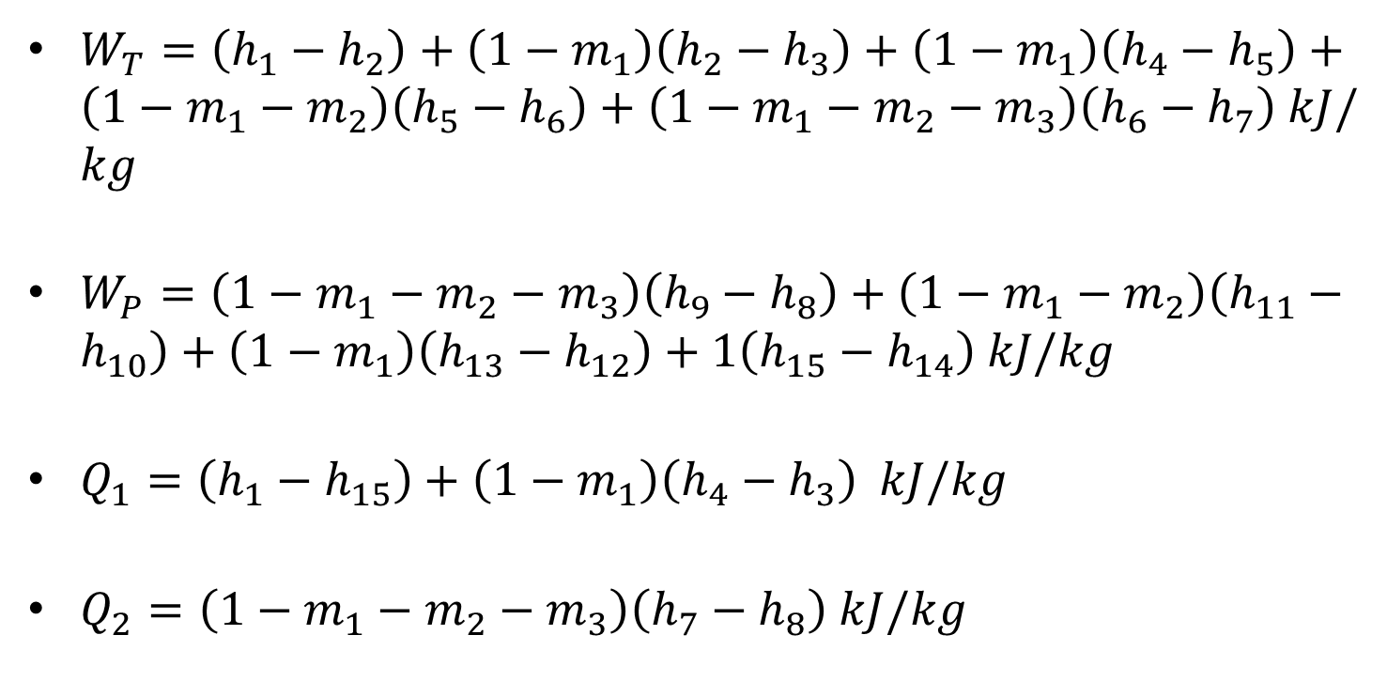
Reheat – regenerative cycle
$W_{T}=\left(h_{1}−h_{2}\right)+\left(1−m_{1}\right)\left(h_{2}−h_{3}\right)+\left(1−m_{1}\right)\left(h_{4}−h_{5}\right)+\left(1−m_{1}−m_{2}\right)\left(h_{5}−h_{6}\right)+\left(1−m_{1}−m_{2}−m_{3}\right)\left(h_{6}−h_{7}\right) kJ/kg$
$W_{P}=\left(1−m_{1}−m_{2}−m_{3}\right)\left(h_{9}−h_{8}\right)+\left(1−m_{1}−m_{2}\right)\left(h_{11}−h_{10}\right)+\left(1−m_{1}\right)\left(h_{13}−h_{12}\right)+1\left(h_{15}−h_{14}\right) kJ/kg$
$Q_{1}=\left(h_{1}−h_{15}\right)+\left(1−m_{1}\right)\left(h_{4}−h_{3}\right) kJ/kg$
$Q_{2}=\left(1−m_{1}−m_{2}−m_{3}\right)\left(h_{7}−h_{8}\right) kJ/kg$

Slide 15
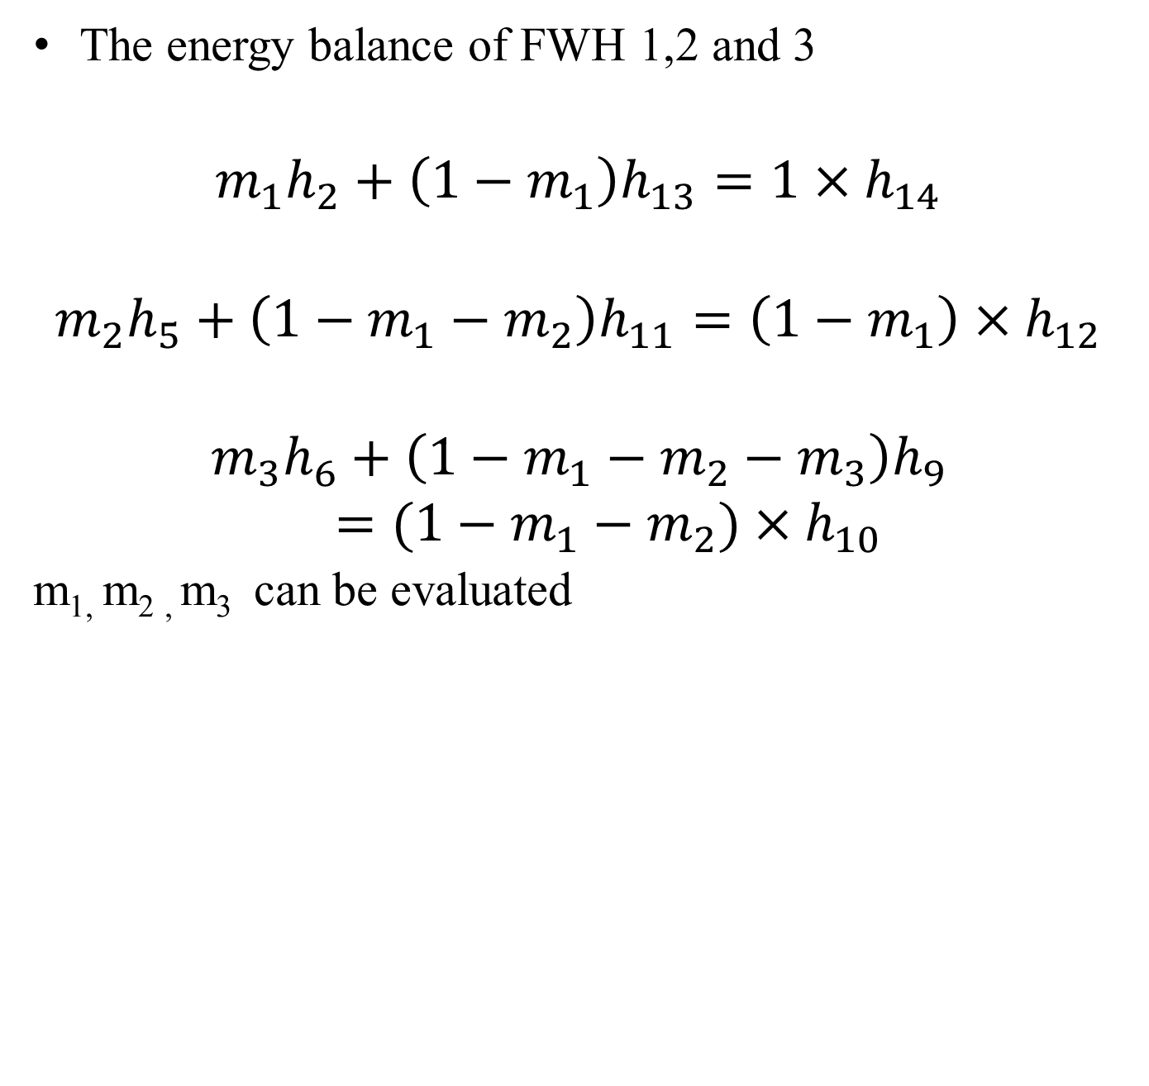
Reheat-regenerative cycle
The energy balance of FWH 1,2 and 3
$$m_{1}h_{2}+\left(1−m_{1}\right)h_{13}=1×h_{14}$$
$$m_{2}h_{5}+\left(1−m_{1}−m_{2}\right)h_{11}=\left(1−m_{1}\right)×h_{12}$$
$$m_{3}h_{6}+\left(1−m_{1}−m_{2}−m_{3}\right)h_{9}=(1−m_{1}−m_{2})×h_{10}$$
m_{1,} m_{2 ,} m₃ can be evaluated

